Slide 1
Shark Tank Results
Thomas Sherk

Slide 2
Changes Since Presentation
I created this presentation in the middle of the experiment, some changes have been made since. Accuracies are different, but this presentation was still a good intro to the dataset and preprocessing techniques.
Biggest change was consolidating state origin to ‘geographic’ origin – I used geographic areas defined the U.S. Census Bureau and consolidated some subregions (East South Central & West South Central -> South Central) if not enough instances occurred.
Some models have been omitted since, and I focused on tuning hyper parameters later on.

Slide 3
Basics
A show that revolves around Startup companies ‘pitching’ their business and trying to secure a favorable deal with 1 or many judges
All startups go through vetting and trials, ~1% of applicants make it to the ‘sharks’
Maximum of 6 judges per episode
Main judges are: Barbara Corcoran, Mark Cuban, Lori Greiner, Robert Herjavec, Daymond John, and Kevin O’Leary with possibility of a guest judge
Deals usually involve a cash amount + equity, but royalty deals are common

Slide 4
What am I trying to Predict
Simple, whether or not a startup will strike a deal with the ‘sharks’.

Slide 5
By what Means?
For this presentation, I have implemented various machine learning algorithms such as single-layered and multi-layered feed-forward networks as well as other algorithms such as SVM, KNN, and Ridge Regression through Matlab
I have also compiled various sources of data which I will go into further detail

Slide 6
Data
I have sourced two sources of data as well as my own and combined all into one spreadsheet
There are 802 records, all of which are representative of each product that has appeared on the show since Season 1 through Season 9

Slide 7
Metadata
Example ↑
The Metadata is broken into 5 subcategories: product category, team demographic (i.e. sex), state, deal (i.e. amount & equity), and judges present
For the sake of the model, certain features didn’t meet requirements (i.e. n < 10). In the case that there were not enough data, I grouped them into ‘other’ within that subcategory.
For example very few startups from Hawaii, Alaska, and Delaware: thus, they go into ‘other’

Slide 8
Data (cont.)
The data was either classified as categorical or numerical
For categorical, a record that satisfies that certain category (i.e. product category = novelties) was denoted with a 1, else 0
For numerical data, I normalized it through:
Min-Max Normalization ((x – min)/(max – min))
This includes amount, equity, and valuation

Slide 9
Descriptive Statistics
Out of 802 records
438 (54.6%) were ‘deals’
364 (45.4%) were ‘no deals’

Slide 10
Descriptive Statistics (Sex)
Out of 802 teams
480 teams (59.9%) were all men
199 teams (24.8%) were all female
123 teams (15.8%) were mixed
The Deal Breakdown is as follows:

Slide 11
Descriptive Statistics (Categories)
Novelties | Health / Wellness | Food and Beverage | Business Services | Lifestyle / Home | Software / Tech | Children / Education | Automotive | Fashion / Beauty | Media / Entertainment | Fitness / Sports / Outdoors | Pet Products | Uncertain / Other
16 | 10 | 71 | 16 | 86 | 21 | 47 | 9 | 65 | 27 | 50 | 16 | 4
35 | 16 | 128 | 47 | 134 | 38 | 73 | 13 | 136 | 55 | 87 | 26 | 14
46% | 63% | 55% | 34% | 64% | 55% | 64% | 69% | 48% | 49% | 57% | 62% | 29%

Slide 12
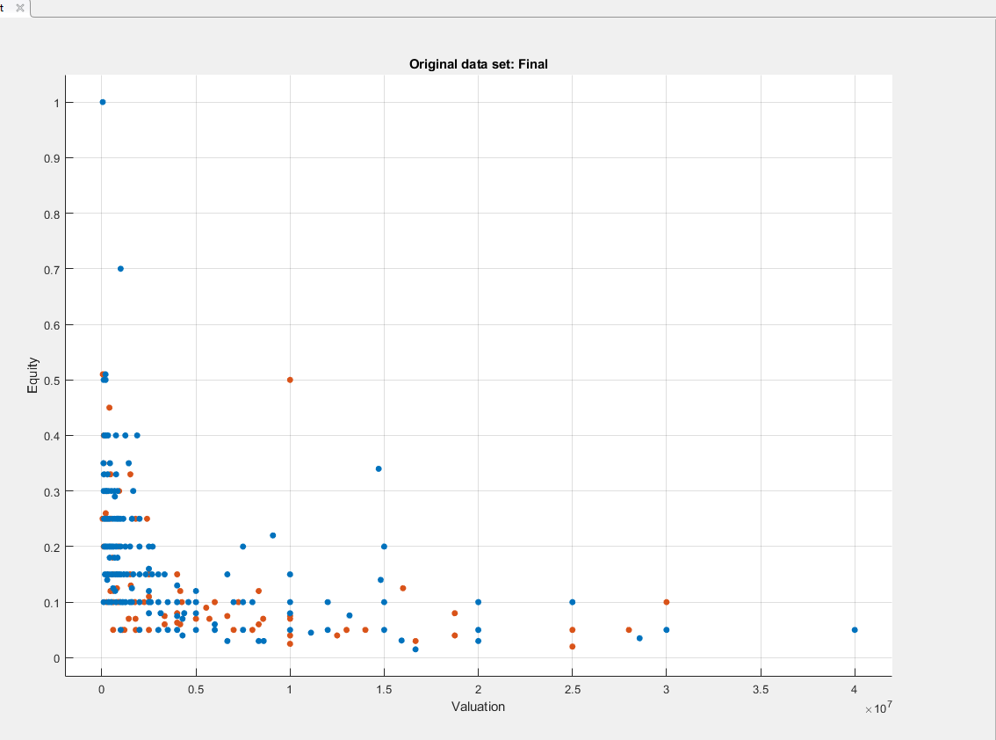
Equity vs Valuation
Orange = ‘Deal’
Blue = ‘No Deal’

Slide 13
FeedForward Results
For training, validation, and testing: I used a 65-15-20 split

Slide 14
Results Continued
Nodes
Model

Slide 15
Results Cont.

Slide 16
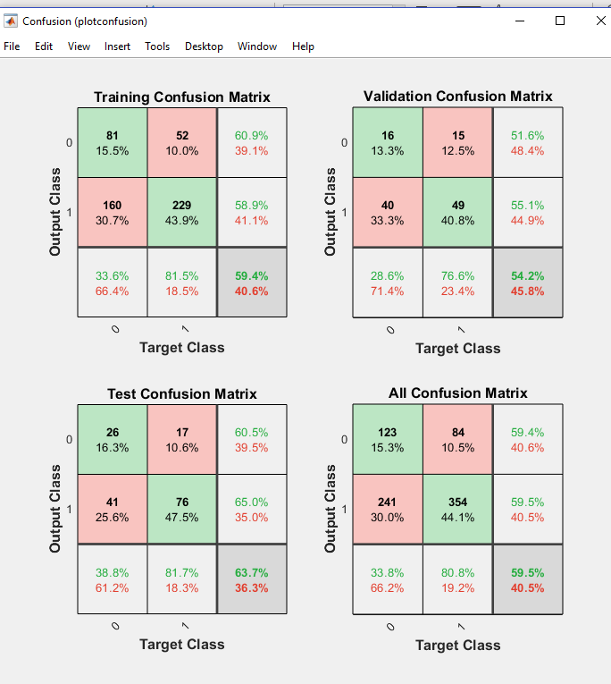
Confusion Matrix

Slide 17
MATLAB Classification Learner
Input data, runs types and varieties of algorithms such as boosted trees, svm, etc.
Hit ‘all’

Slide 18
Results (Cont)

Slide 19
Results Cont.

Slide 20
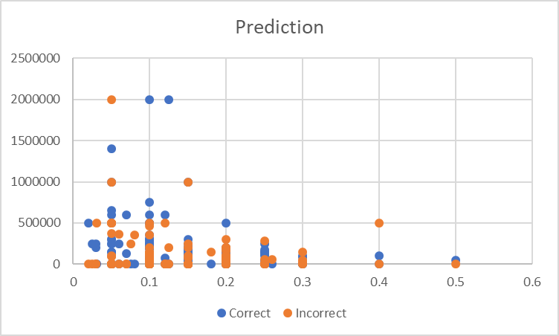
Results Continued

Slide 21
Moving Forward
Continue to mine for results/patterns, is there something the model predicts especially well that I could further test?
Limitations of data

